Slide 1

CMPUT 328 Fall 2020
Assignment 2 Logistic Regression and Hyperparameter Search

Slide 2
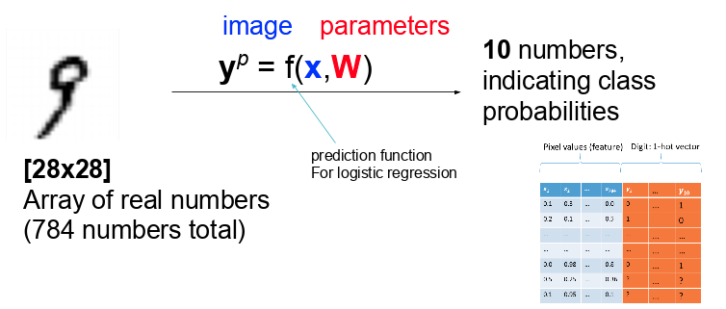
Logistic Regression:

Slide 3
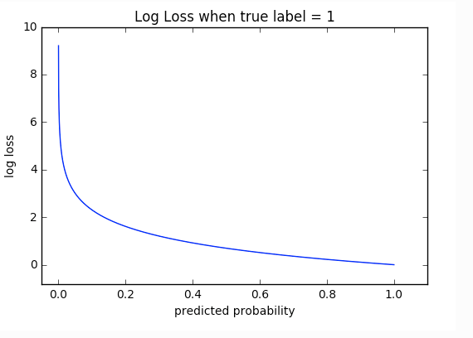

Loss Function : Cross Entropy
Cross-entropy loss, or log loss, measures the performance of a classification model whose output is a probability value between 0 and 1. Cross-entropy loss increases as the predicted probability diverges from the actual label.

Slide 4
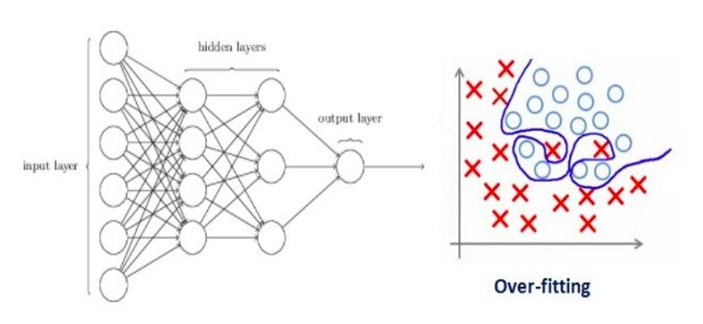
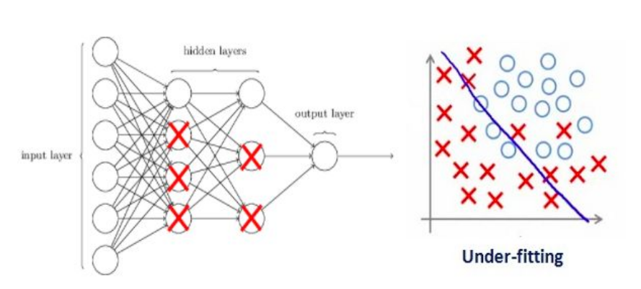
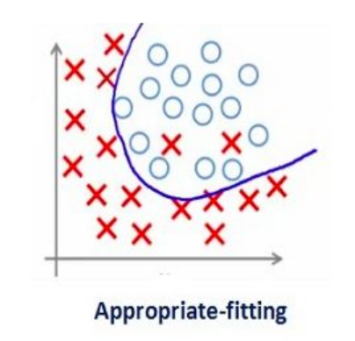
Regularization:
A way to penalize the weight matrices of the nodes.
We update the general cost function by adding another term known as the regularization term.
Cost function = Loss (say, binary cross entropy) + Regularization term
Due to the addition of this regularization term, the values of weight matrices decrease because it assumes that a neural network with smaller weight matrices leads to simpler models. Therefore, it will also reduce overfitting to quite an extent.

Slide 5
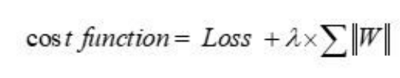
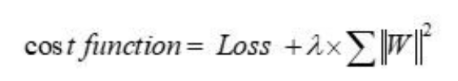
Regularization:
L1 Regularization:
L2 Regularization:
Notes:
Here, lambda is the regularization hyperparameter, whose value is optimized over the validation set for better results. L2 regularization is also known as weight decay as it forces the weights to decay towards zero (but not exactly zero).

Slide 6
Datasets

Slide 7
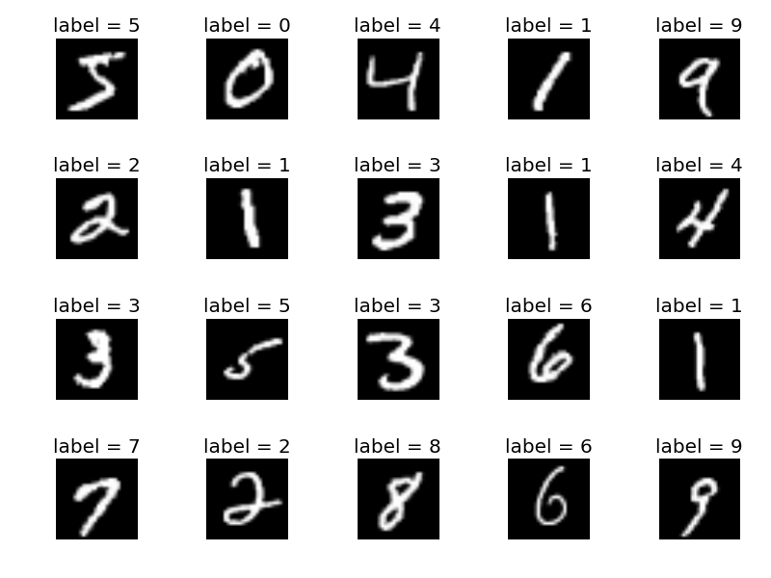
[1] MNIST Dataset
28x28 Binary images of handwritten digits
60K training, 5K testing images

Slide 8
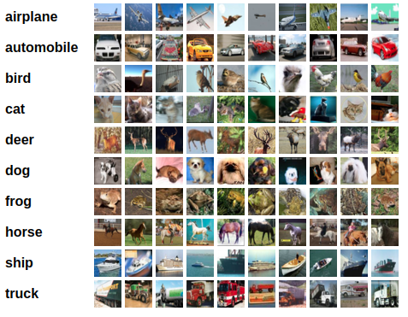
[2] CIFAR-10 Dataset
32x32 RGB images of different objects
60000 in 10 classes, with 6000 images per class, divided as 50000 training images and 10000 test images.

Slide 9
Different Data splits:
Train Data (48000), originally (60000)
Validation Data (12,000): Subset of the train data
Test Data: Shouldn’t be included in the training process, even for fine-tuning the hyperparameters

Slide 10
Data loaders:
A way to combine a dataset and a sampler, and provides an iterable over the given dataset.
To create data iterator:
dataiter = iter(trainloader)
images, labels = dataiter.next()
To iterate in a loop:
for data in enumerate(dataloader):
Image, label = data

Slide 11
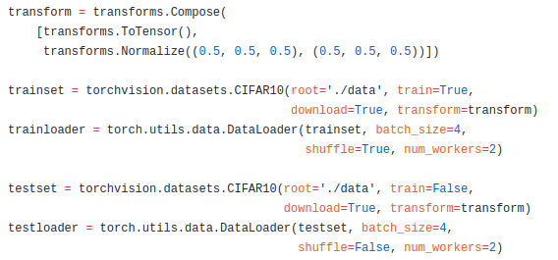
Data loaders:
An example over Cifar10 would be:

Slide 12
Implementation Steps:
Define your train, validation, and test data loaders in PyTorch
Define your model
Define cross entropy loss
Add weight regularization to the loss
Training loop
Validation after every 5 epochs
Choose your best-hyperparameters on the validation set
Test the model on the test-set and return the test-predictions from the function

Slide 13
Optimization

Slide 14
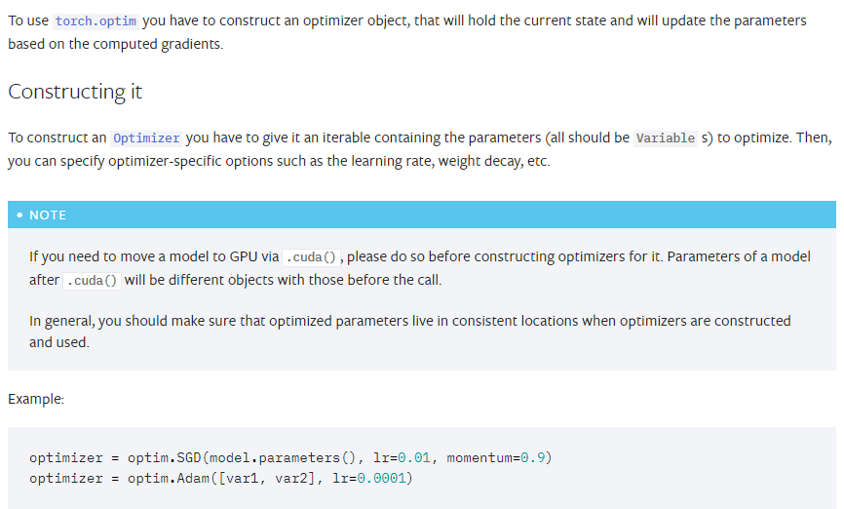
Optimization in Pytorch:
torch.optim is a package implementing various optimization algorithms. For example: Adadelta, Adagrad, Adam, SparseAdam, Adamax, ASGD, RMSprop, SGD etc
Ref: https://pytorch.org/docs/stable/optim.html

Slide 15
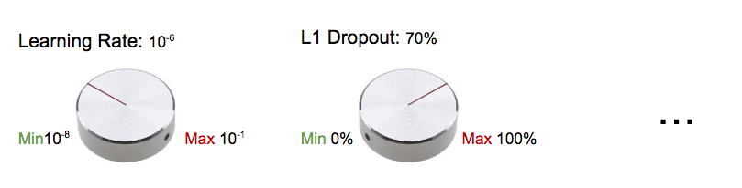
Hyper-parameter:
Hyperparameters are the knobs that you can turn when building your machine / deep learning model. .
Or,
Hyperparameters are all the training variables set manually with a pre-determined value before starting the training.
Ref: https://blog.floydhub.com/guide-to-hyperparameters-search-for-deep-learning-models/

Slide 16
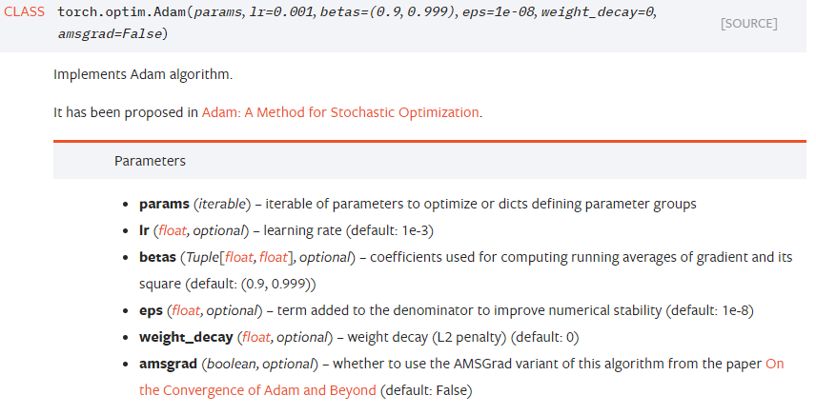
Adam:

Slide 17
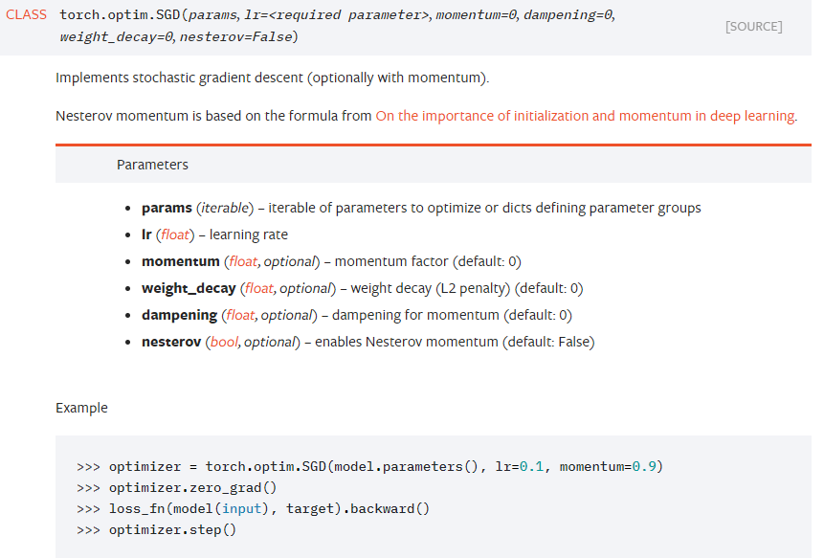
SGD

Slide 18
Useful PyTorch functions:
Optimizer: Adam, SGD, etc:
torch.nn.CrossEntropyLoss
Data Loader : torchvision.datasets.MNIST, torchvision.datasets.CIFAR10
Data Samplers
torch.max(tensor)

